Slide 1
Experiment
Week | Experiment | Room
7 | Experiment 1: Programming with MS Visual Studio | 10-414
12 | Experiment 2: Branch and loop programming | 10-413
15 | Experiment 3: Procedure programming
Please bring your own laptop (with x86 CPU) if possible.
Irvine, Kip R. Assembly Language for Intel-Based Computers 5/e, 2007.

Slide 2


Chapter 6a: Homework
1. Write an application that does the following:
(1) fill an array with 20 random integers;
(2) loop through the array, displaying each value, and count the number of negative values;
(3) after the loop finishes, display the count.
Note: The Random32 procedure from the Irvine32 library generates random integers.
2. Write a program that calculates and displays the Fibonacci number sequence {1, 1, 2, 3, 5, 8, 13, . . .}, stopping only when the Carry flag is set. Display each unsigned decimal integer value on a separate line.
Irvine, Kip R. Assembly Language for Intel-Based Computers 5/e, 2007.

Slide 3
Assembly Language for Intel-Based Computers, 6th Edition
Kip R. Irvine
Chapter 6: Conditional Processing
Slides prepared by the author
Revision date: June 4, 2006
(c) Pearson Education, 2006-2007. All rights reserved. You may modify and copy this slide show for your personal use, or for use in the classroom, as long as this copyright statement, the author's name, and the title are not changed.

Slide 4
What's Next
Boolean and Comparison Instructions
Conditional Jumps
Conditional Loop Instructions
Conditional Structures
Application: Finite-State Machines
Decision Directives
Irvine, Kip R. Assembly Language for Intel-Based Computers 5/e, 2007.

Slide 5
Conditional Structures
Block-Structured IF Statements
Compound Expressions with AND
Compound Expressions with OR
WHILE Loops
Table-Driven Selection
Irvine, Kip R. Assembly Language for Intel-Based Computers 5/e, 2007.

Slide 6
Block-Structured IF Statements
Assembly language programmers can easily translate logical statements written in C++/Java into assembly language. For example:
if( op1 == op2 )
X = 1;
else
X = 2;
  mov eax,op1
  cmp eax,op2
  jne L1
  mov X,1
  jmp L2
L1: mov X,2
L2:
Irvine, Kip R. Assembly Language for Intel-Based Computers 5/e, 2007.

Slide 7
Your turn . . .
Implement the following pseudocode in assembly language. All values are unsigned:
if( ebx <= ecx )
{
eax = 5;
edx = 6;
}
  cmp ebx,ecx
  ja next
  mov eax,5
  mov edx,6
next:
(There are multiple correct solutions to this problem.)
Irvine, Kip R. Assembly Language for Intel-Based Computers 5/e, 2007.

Slide 8
Your turn . . .
Implement the following pseudocode in assembly language. All values are 32-bit signed integers:
if( var1 <= var2 )
var3 = 10;
else
{
var3 = 6;
var4 = 7;
}
  mov eax,var1
  cmp eax,var2
  jle L1
  mov var3,6
  mov var4,7
  jmp L2
L1: mov var3,10
L2:
(There are multiple correct solutions to this problem.)
Irvine, Kip R. Assembly Language for Intel-Based Computers 5/e, 2007.

Slide 9
Compound Expression with AND (1 of 3)
When implementing the logical AND operator, consider that HLLs use short-circuit evaluation
In the following example, if the first expression is false, the second expression is skipped:
if (al > bl) AND (bl > cl)
X = 1;
Irvine, Kip R. Assembly Language for Intel-Based Computers 5/e, 2007.

Slide 10
Compound Expression with AND (2 of 3)
if (al > bl) AND (bl > cl)
X = 1;
This is one possible implementation . . .
cmp al,bl ; first expression...
ja L1
jmp next
L1:
cmp bl,cl ; second expression...
ja L2
jmp next
L2: ; both are true
mov X,1 ; set X to 1
next:
Irvine, Kip R. Assembly Language for Intel-Based Computers 5/e, 2007.

Slide 11
Compound Expression with AND (3 of 3)
if (al > bl) AND (bl > cl)
X = 1;
But the following implementation uses 29% less code by reversing the first relational operator. We allow the program to "fall through" to the second expression:
cmp al,bl ; first expression...
jbe next ; quit if false
cmp bl,cl ; second expression...
jbe next ; quit if false
mov X,1 ; both are true
next:
Irvine, Kip R. Assembly Language for Intel-Based Computers 5/e, 2007.

Slide 12
Your turn . . .
Implement the following pseudocode in assembly language. All values are unsigned:
if( ebx <= ecx
&& ecx > edx )
{
eax = 5;
edx = 6;
}
  cmp ebx,ecx
  ja next
  cmp ecx,edx
  jbe next
  mov eax,5
  mov edx,6
next:
(There are multiple correct solutions to this problem.)
Irvine, Kip R. Assembly Language for Intel-Based Computers 5/e, 2007.

Slide 13
Compound Expression with OR (1 of 2)
When implementing the logical OR operator, consider that HLLs use short-circuit evaluation
In the following example, if the first expression is true, the second expression is skipped:
if (al > bl) OR (bl > cl)
X = 1;
Irvine, Kip R. Assembly Language for Intel-Based Computers 5/e, 2007.

Slide 14
Compound Expression with OR (1 of 2)
if (al > bl) OR (bl > cl)
X = 1;
We can use "fall-through" logic to keep the code as short as possible:
cmp al,bl ; is AL > BL?
ja L1 ; yes
cmp bl,cl ; no: is BL > CL?
jbe next ; no: skip next statement
L1: mov X,1 ; set X to 1
next:
Irvine, Kip R. Assembly Language for Intel-Based Computers 5/e, 2007.

Slide 15
WHILE Loops
A WHILE loop is really an IF statement followed by the body of the loop, followed by an unconditional jump to the top of the loop. Consider the following example:
while( eax < ebx)
eax = eax + 1;
This is a possible implementation:
top: cmp eax,ebx ; check loop condition
jae next ; false? exit loop
inc eax ; body of loop
jmp top ; repeat the loop
next:
Irvine, Kip R. Assembly Language for Intel-Based Computers 5/e, 2007.

Slide 16
Your turn . . .
Implement the following loop, using unsigned 32-bit integers:
while( ebx <= val1)
{
ebx = ebx + 5;
val1 = val1 - 1
}
top: cmp ebx,val1 ; check loop condition
ja next ; false? exit loop
add ebx,5 ; body of loop
dec val1
jmp top ; repeat the loop
next:
Irvine, Kip R. Assembly Language for Intel-Based Computers 5/e, 2007.

Slide 17
Table-Driven Selection (1 of 3)
Table-driven selection uses a table lookup to replace a multiway selection structure
Create a table containing lookup values and the offsets of labels or procedures
Use a loop to search the table
Suited to a large number of comparisons
Irvine, Kip R. Assembly Language for Intel-Based Computers 5/e, 2007.

Slide 18
Table-Driven Selection (2 of 3)
Step 1: create a table containing lookup values and procedure offsets:
.data
CaseTable BYTE 'A' ; lookup value
DWORD Process_A ; address of procedure
EntrySize = ($ - CaseTable)
BYTE 'B'
DWORD Process_B
BYTE 'C'
DWORD Process_C
BYTE 'D'
DWORD Process_D
NumberOfEntries = ($ - CaseTable) / EntrySize
Irvine, Kip R. Assembly Language for Intel-Based Computers 5/e, 2007.

Slide 19
Table-Driven Selection (3 of 3)
Step 2: Use a loop to search the table. When a match is found, we call the procedure offset stored in the current table entry:
mov ebx,OFFSET CaseTable ; point EBX to the table
mov ecx,NumberOfEntries ; loop counter
L1: cmp al,[ebx] ; match found?
jne L2 ; no: continue
call NEAR PTR [ebx + 1] ; yes: call the procedure
jmp L3 ; and exit the loop
L2: add ebx,EntrySize ; point to next entry
loop L1 ; repeat until ECX = 0
L3:
required for procedure pointers
Irvine, Kip R. Assembly Language for Intel-Based Computers 5/e, 2007.

Slide 20
What's Next
Boolean and Comparison Instructions
Conditional Jumps
Conditional Loop Instructions
Conditional Structures
Application: Finite-State Machines
Decision Directives
Irvine, Kip R. Assembly Language for Intel-Based Computers 5/e, 2007.

Slide 21
Application: Finite-State Machines
A finite-state machine (FSM) is a graph structure that changes state based on some input. Also called a state-transition diagram.
We use a graph to represent an FSM, with squares or circles called nodes, and lines with arrows between the circles called edges (or arcs).
A FSM is a specific instance of a more general structure called a directed graph (or digraph).
Three basic states, represented by nodes:
  Start state
  Terminal state(s)
  Nonterminal state(s)
Irvine, Kip R. Assembly Language for Intel-Based Computers 5/e, 2007.

Slide 22
Finite-State Machine
Accepts any sequence of symbols that puts it into an accepting (final) state
Can be used to recognize, or validate a sequence of characters that is governed by language rules (called a regular expression)
Advantages:
  Provides visual tracking of program's flow of control
  Easy to modify
  Easily implemented in assembly language
Irvine, Kip R. Assembly Language for Intel-Based Computers 5/e, 2007.

Slide 23
FSM Examples
FSM that recognizes strings beginning with 'x', followed by letters 'a'..'y', ending with 'z':
FSM that recognizes signed integers:
Irvine, Kip R. Assembly Language for Intel-Based Computers 5/e, 2007.

Slide 24
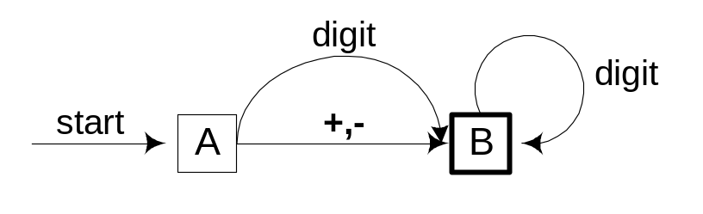
Your turn . . .
Explain why the following FSM does not work as well for signed integers as the one shown on the previous slide:
The previous FSM that recognizes signed integers:
Irvine, Kip R. Assembly Language for Intel-Based Computers 5/e, 2007.

Slide 25
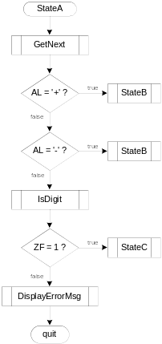
Flowchart of State A
State A accepts a plus or minus sign, or a decimal digit.
Irvine, Kip R. Assembly Language for Intel-Based Computers 5/e, 2007.

Slide 26
IsDigit Procedure
Receives a character in AL. Sets the Zero flag if the character is a decimal digit.
IsDigit PROC
cmp al,'0' ; ZF = 0
jb ID1
cmp al,'9' ; ZF = 0
ja ID1
test ax,0 ; ZF = 1
ID1: ret
IsDigit ENDP
Irvine, Kip R. Assembly Language for Intel-Based Computers 5/e, 2007.

Slide 27

Implementing an FSM
The following is code from State A in the Integer FSM:
StateA:
call Getnext ; read next char into AL
cmp al,'+' ; leading + sign?
je StateB ; go to State B
cmp al,'-' ; leading - sign?
je StateB ; go to State B
call IsDigit ; ZF = 1 if AL = digit
jz StateC ; go to State C
call DisplayErrorMsg ; invalid input found
jmp Quit
View the Finite.asm source code.
Irvine, Kip R. Assembly Language for Intel-Based Computers 5/e, 2007.

Slide 28
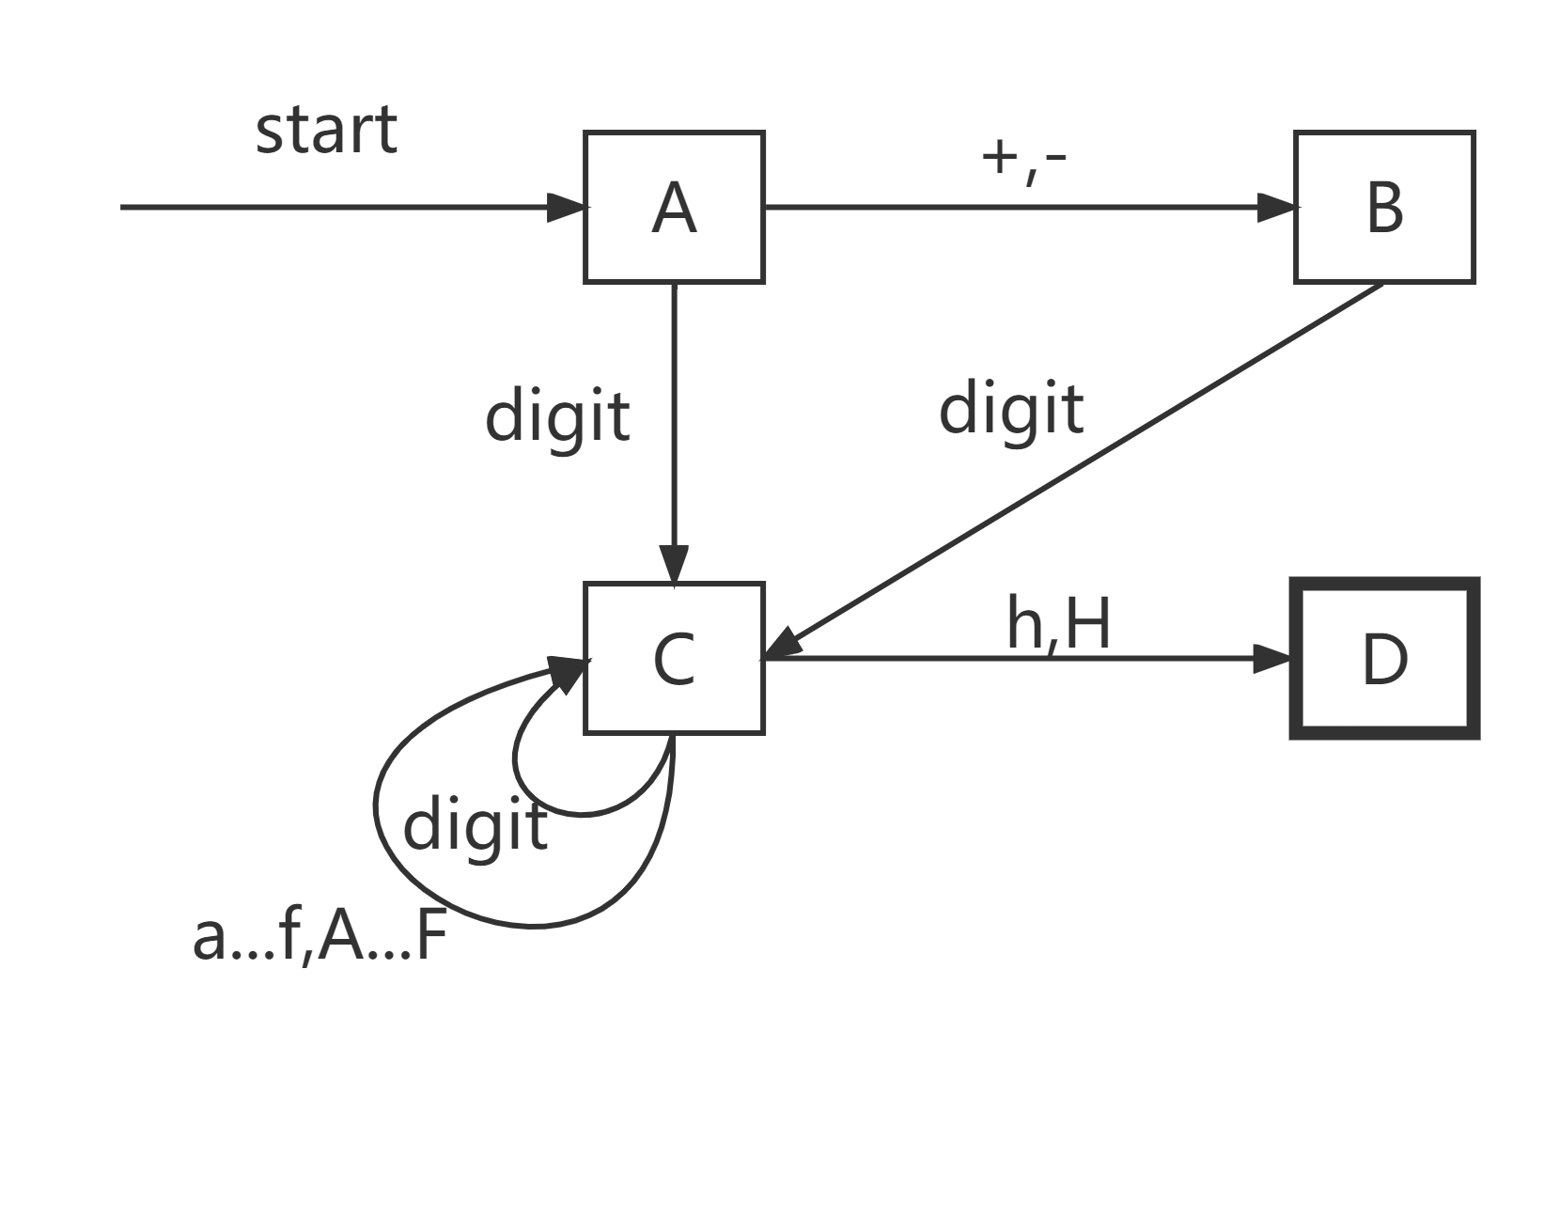
Your turn . . .
Draw a FSM diagram for hexadecimal integer constant that conforms to MASM syntax.
  Integer format: [{+ | −}] digits [radix]
  Hexadecimal beginning with letter must have a leading zero
Irvine, Kip R. Assembly Language for Intel-Based Computers 5/e, 2007.

Slide 29
What's Next
Boolean and Comparison Instructions
Conditional Jumps
Conditional Loop Instructions
Conditional Structures
Application: Finite-State Machines
Decision Directives
Irvine, Kip R. Assembly Language for Intel-Based Computers 5/e, 2007.

Slide 30
Using the .IF Directive
Runtime Expressions
Relational and Logical Operators
MASM-Generated Code
.REPEAT Directive
.WHILE Directive
Irvine, Kip R. Assembly Language for Intel-Based Computers 5/e, 2007.

Slide 31
Runtime Expressions
.IF, .ELSE, .ELSEIF, and .ENDIF can be used to evaluate runtime expressions and create block-structured IF statements.
Examples:
.IF eax > ebx
mov edx,1
.ELSE
mov edx,2
.ENDIF
.IF eax > ebx && eax > ecx
mov edx,1
.ELSE
mov edx,2
.ENDIF
MASM generates "hidden" code for you, consisting of code labels, CMP and conditional jump instructions.
The bitwidth of the two operands of a comparison should be the same.
Irvine, Kip R. Assembly Language for Intel-Based Computers 5/e, 2007.

Slide 32
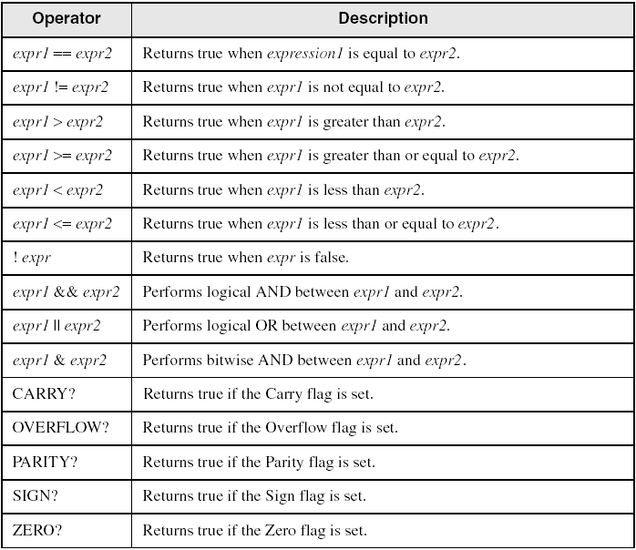
Relational and Logical Operators
Irvine, Kip R. Assembly Language for Intel-Based Computers 5/e, 2007.

Slide 33
MASM-Generated Code
.data
val1 DWORD 5
result DWORD ?
.code
mov eax,6
.IF eax > val1
mov result,1
.ENDIF
Generated code:
mov eax,6
cmp eax,val1
jbe @C0001
mov result,1
@C0001:
MASM automatically generates an unsigned jump (JBE) because val1 is unsigned.
Irvine, Kip R. Assembly Language for Intel-Based Computers 5/e, 2007.

Slide 34
MASM-Generated Code
.data
val1 SDWORD 5
result SDWORD ?
.code
mov eax,6
.IF eax > val1
mov result,1
.ENDIF
Generated code:
mov eax,6
cmp eax,val1
jle @C0001
mov result,1
@C0001:
MASM automatically generates a signed jump (JLE) because val1 is signed.
Irvine, Kip R. Assembly Language for Intel-Based Computers 5/e, 2007.

Slide 35
MASM-Generated Code
.data
result DWORD ?
.code
mov ebx,5
mov eax,6
.IF eax > ebx
mov result,1
.ENDIF
Generated code:
mov ebx,5
mov eax,6
cmp eax,ebx
jbe @C0001
mov result,1
@C0001:
MASM automatically generates an unsigned jump (JBE) when both operands are registers . . .
Irvine, Kip R. Assembly Language for Intel-Based Computers 5/e, 2007.

Slide 36
MASM-Generated Code
.data
result SDWORD ?
.code
mov ebx,5
mov eax,6
.IF SDWORD PTR eax > ebx
mov result,1
.ENDIF
Generated code:
mov ebx,5
mov eax,6
cmp eax,ebx
jle @C0001
mov result,1
@C0001:
. . . unless you prefix one of the register operands with the SDWORD PTR operator. Then a signed jump is generated.
If any operand of a comparison is signed, a signed jump is generated.
Irvine, Kip R. Assembly Language for Intel-Based Computers 5/e, 2007.

Slide 37
.REPEAT Directive
Executes the loop body before testing the loop condition associated with the .UNTIL directive.
Example:
; Display integers 1 – 10:
mov eax,0
.REPEAT
inc eax
call WriteDec
call Crlf
.UNTIL eax == 10
Irvine, Kip R. Assembly Language for Intel-Based Computers 5/e, 2007.

Slide 38
.WHILE Directive
Tests the loop condition before executing the loop body The .ENDW directive marks the end of the loop.
Example:
; Display integers 1 – 10:
mov eax,0
.WHILE eax < 10
inc eax
call WriteDec
call Crlf
.ENDW
Irvine, Kip R. Assembly Language for Intel-Based Computers 5/e, 2007.

Slide 39
Summary
Bitwise instructions (AND, OR, XOR, NOT, TEST)
  manipulate individual bits in operands
CMP – compares operands using implied subtraction
  sets condition flags
Conditional Jumps & Loops
  equality: JE, JNE
  flag values: JC, JZ, JNC, JP, ...
  signed: JG, JL, JNG, ...
  unsigned: JA, JB, JNA, ...
  LOOPZ, LOOPNZ, LOOPE, LOOPNE
Flowcharts – logic diagramming tool
Finite-state machine – tracks state changes at runtime
Irvine, Kip R. Assembly Language for Intel-Based Computers 5/e, 2007.

Slide 40

The End
Irvine, Kip R. Assembly Language for Intel-Based Computers 5/e, 2007.

